Slide 1
Cybersecurity
RFID and NFC Attacks

Slide 2
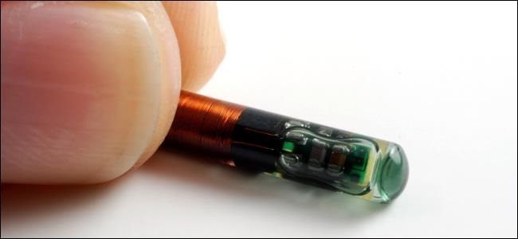
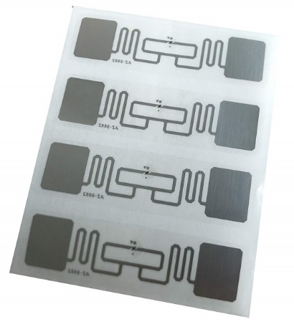
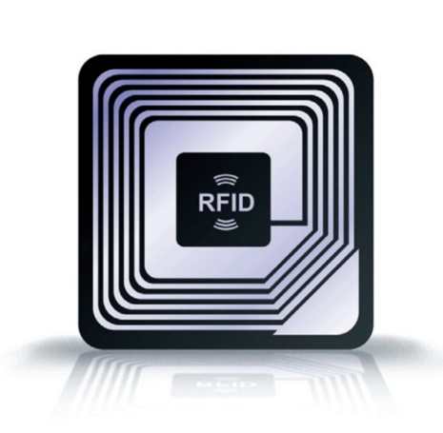
RFID
Radio-Frequency Identification
Allows wireless communication between a reader and an RFID “tag”
Tag can be active or passive
Active = “powered” radio transmission
Passive = unpowered, harnesses radio energy from transmitter to respond when activated by radio signal
Applications
Inventory tracking
Pet identification
ProxCard
Secure access
Hotel room key cards

Slide 3
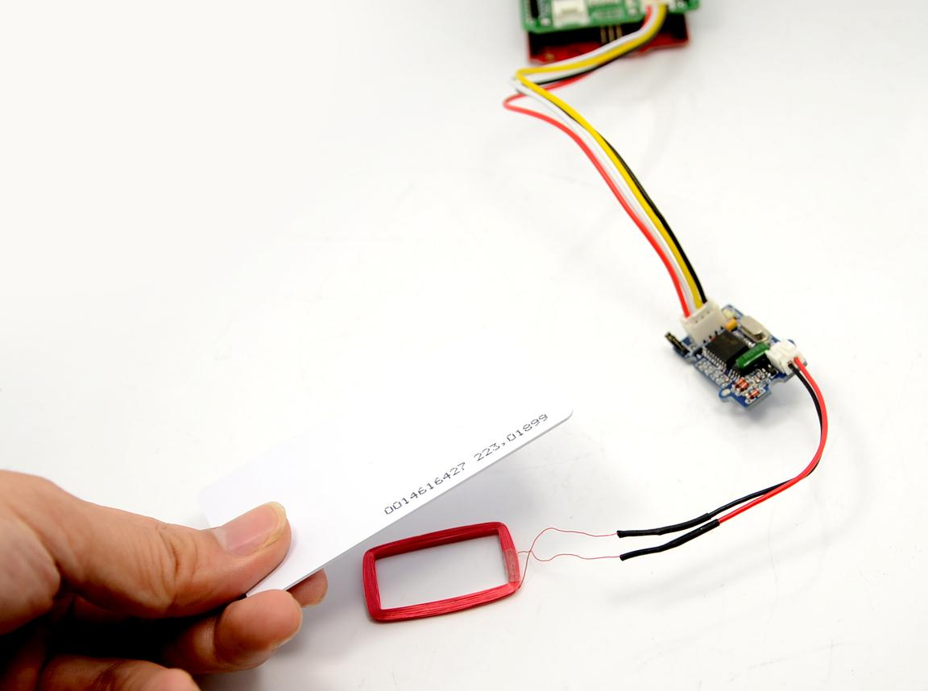
RFID Attacks
Decrypt communications
Most default keys publicly available
Replay attack
Act as reader
Record signal from RFID tag
Replay for access
Act as reader
Record responding ID, write to your own RFID tag
Useful to access secure areas
Jam signal
Transmit louder signal at same frequency

Slide 4
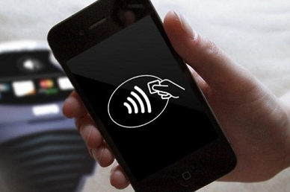
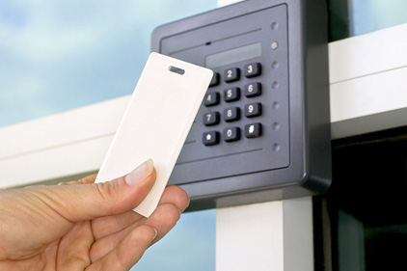
Near Field Communication (NFC)
Short range, two way wireless communication
Kicks off communication for other wireless
NFC can assist Bluetooth pairing
Used for payment systems
Access token, secure ProxCard

Slide 5

NFC Security Concerns
Relay/Replay attack
Remote capture
Jam signal
Transmit louder signal at same frequency
Loss or stolen NFC token (phone)

